Slide 1

10-Step Google Analytics Audit
How to Ensure Accurate Insights for Better Business Reporting & Traffic Analysis

Slide 2
Google Analytics
10-Step Google Analytics Audit
How to Ensure Accurate Insights for Better Business Reporting & Traffic Analysis
As an E-Commerce Web-Based Business or Agency
What You Must Know for Better Decision-Making & Profitability:
Website Traffic Quantity, Quality – Time On Site, Time on Page, Bounce
Where Visitors Come From – Source, Keywords
Where Users Go – Funnels, Trails
What Prospects Do – Transactions, Goals
How They Behave On-Site – Searches, Conversions, Exits
Results – Revenue, Ecommerce
What You’re Likely to Get, if You’re Not Careful:
Garbage In, Garbage Out

Slide 3
Google Analytics
Why Audit Analytics? Again?
Developer Upgrades, Changes Code Edits SEO Optimizations
Design Revisions Content Edits Added or Deleted Pages / Products / Services
Your Team Gets Bigger with Each Passing Day… They Disrupt Analytics
Developer
Backend Programmer
Database Administrator
Host or Server Admin
E-Commerce Manager
Web Designer
SEO Agent
Social Media Maven
Notes:
Make this a routine. Audit regularly. Agencies must audit immediately upon client signup. Good Analytics data provides the actionable framework to build business logic and make the smartest marketing decisions. Quality Assurance testing is essential to good data. When you provide a sensible dashboard for this intelligence, you will be speaking the language of revenue, of verifiable facts and trends. In short, you will be speaking the language of business. That is something that your customer, likely an E-Com manager, or Operations Executives, or Product manager, will understand and appreciate. These business people cannot operate blindly (at least, not for long)! Give them the data they need to gain insights to inform decisions.
Audit with breadth (sitewide tag survey) and depth (filters, tags, segments). Audit frequently. Remember, any time a developer makes a change, or a content writer edits copy, or an E-Com manager adds new products, the Analytics is subject to change and therefore, verification.

Slide 4
Google Analytics
When to Audit Analytics?
Accuracy Actionable Info Assessment
Design Revisions Content or Code Edits Added or Deleted Products / Services
Make this a routine. AUDIT REGULARLY.
Initial Checkup – Immediately
Business Logic Changes – At Launch
Quality Assurance – Periodically
Dashboard Effectiveness – Continuous Improvement
Walk the Talk – Demonstrate Insight
Please the Client / Boss – Revenue Focus for E-Com Mgr., Executives
AUDIT WITH BREADTH: site-wide tag survey.
AUDIT WITH DEPTH: filters, tags, segments, etc.
Notes:
Make this a routine. Audit regularly. Agencies must audit immediately upon client signup. Good Analytics data provides the actionable framework to build business logic and make the smartest marketing decisions. Quality Assurance testing is essential to good data. When you provide a sensible dashboard for this intelligence, you will be speaking the language of revenue, of verifiable facts and trends. In short, you will be speaking the language of business. That is something that your customer, likely an E-Com manager, or Operations Executives, or Product manager, will understand and appreciate. These business people cannot operate blindly (at least, not for long)! Give them the data they need to gain insights to inform decisions.
Audit with breadth (sitewide tag survey) and depth (filters, tags, segments). Audit frequently. Remember, any time a developer makes a change, or a content writer edits copy, or an E-Com manager adds new products, the Analytics is subject to change and therefore, verification.

Slide 5
Google Analytics
10-Step Google Analytics Audit
Traffic Source: (not provided)
Unify Results for Easier Interpretation
Custom Reports to Maximize Revenue
Macro AND Micro Conversions
Mobile Website Conversion Tracking
URL Tagging
Account Filters
Bounces by Traffic Type
Site Search Tracking
Google Analytics Code Audit
PLUS 3 TIPS:
Funnels: Product Page Add to Cart VS Category Page Add to Cart
Alerts - Google Intelligent Alerts are just plain smart!
Tools & Resources

Slide 6
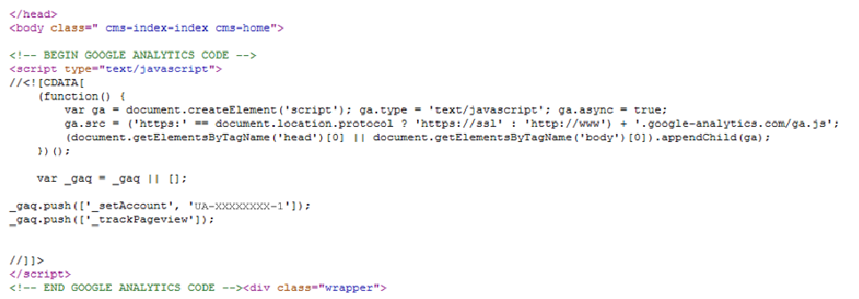
Google Analytics Code Audit
1. Google Analytics Code Audit
Confirm ALL pages bear Google Analytics tracking code.
Check for OLD (Urchin) or ALIEN (other Account Numbers) or DUPLICATE or MIXED (both old and new) GA tracking code on any pages.
Check code position… It should be within the <head> tags.
CORRECT IT. Consider adding the PageSpeed tracking code to the script.
Notes:
Detect the Google Analytics tracking code to be present on all the pages
Check for OLD (Urchin) or alien (other Account Numbers) or duplicate GA tracking code on any of the pages.
If the tracking code is implemented the right number of times on all the pages, check the position of the code.. It should be within the <head> tags. Google recommends to place the GA code in the head, above the closing </head> tag.
RECOMMEND: To ensure that the accuracy of the data, move the Tracking Code above the closing head tag </head> on all pages.
Consider adding the PageSpeed tracking code to the script.

Slide 7
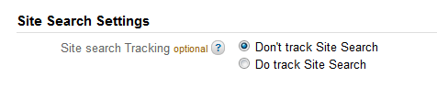
Google Analytics Site Search Tracking
2. Site Search Tracking
Determine whether Site Search is being tracked.
Site search is a customer service. Accurately track what users are searching for, to:
decide what content to promote on your website,
what products are the most sought-after, and
what is so difficult to find that users must resort to site search to find it.
RECOMMEND: establish Analytics tracking and reporting of On-Site Search queries. Examine the downstream page to get a a sense for where users go next and whether they find the search results useful.
Notes:
Determine whether site search is being tracked.
When a user resorts to Site Search, it indicates two things: 1) they are motivated 2) they can’t find what they thought they would when they clicked through to your site
Site search is a valuable tool for any website. Accurately tracking what users are searching for helps you to decide what content to promote on your website, what products are the most sought-after, and what is so difficult to find that users must resort to site search to find it.

Slide 8
Google Analytics Bounce Rates by Type of Traffic
3. Bounces by Type of Traffic:
Returning Visitors
Compare Bounce Rates among Paid, New, and Returning Visitors.
Here, Bounce Rate for Returning Visitors almost 50% worse than the site's average.
Returning Visitors should be MORE engaged than New Visitors. Is your site fostering a rewarding relationship? To retain repeat traffic, ensure that they have a good reason to return, such as a compelling offer or an engaging story. Be certain they land on the right page. Afford them easy one-step access to the pages or products they considered before. Optimize your E-mail & newsletter communications to consistently add value.
Notes:
Bounces by Type of Traffic: Returning Visitors
Bounce rate for returning visitors is more than 10% worse than the site's average.
If returning visitors are less engaged than new visitors, this could be a sign that your site isn't fostering a prolonged relationship with its visitors. To drive engaged repeat traffic, ensure that your visitors have a good reason to return to your site, such as a compelling offer or an engaging story. Be certain they land on the right page and that your email/newsletter communications are optimized to consistently add value.

Slide 9
Google Analytics Bounce Rates by Type of Traffic
3. Bounces by Type of Traffic:
Paid Visitors
Compare Bounce Rates among Paid, New, and Returning Visitors.
Here, Bounce Rate for Paid Visitors is almost 24% worse than the site's average.
Of all the traffic sources, paid search is the source you have the most control over. You control keywords, ad text, and landing pages. This traffic source can drive some of your most engaged and effective traffic. Always be sure to tie keyword and ad text to a landing page's content.
Notes:
Compare Bounce Rates among Paid, New, and Returning Visitors.
Here, Bounce Rate for Paid Visitors is almost 10% worse than the site's average.
Of all the traffic sources, paid search is the source you have the most control over. You control keywords, ad text, and landing pages. This traffic source can drive some of your most engaged and effective traffic. Always be sure to tie keyword and ad text to a landing page's content. WebiMax is looking forward to the engagement of our services to effect this and identify other ways to ensure the effectiveness of paid search.

Slide 10
Google Analytics Bounce Rates by Type of Traffic
3. Bounces by Type of Traffic:
New Visitors
Compare Bounce Rates among Paid, New, and Returning Visitors.
Bounce rate for New Visitors is about 13% better than the site's average.
Attracting and Engaging New Visitors is crucial for driving conversions. Issues driving bounce rate in new visitors include campaign messaging, landing page layout and content. Integrate all of your campaign messaging with your landing page text, optimize your calls to action, and test your landing page layouts.
Notes:
Compare Bounce Rates among Paid, New, and Returning Visitors.
Here, Bounce Rate for New Visitors is on par with the site's average.
New Visitors
The engagement level of new visitors is crucial for driving conversions. Several issues could drive bounce rate in new visitors, including campaign messaging, landing page layout, and landing page text. To better engage your new visitors, make sure you align your campaign messaging with your landing page text, optimize your calls to action, and test your landing page layouts. For more information, contact us to help you develop ways to optimize your landing pages.

Slide 11
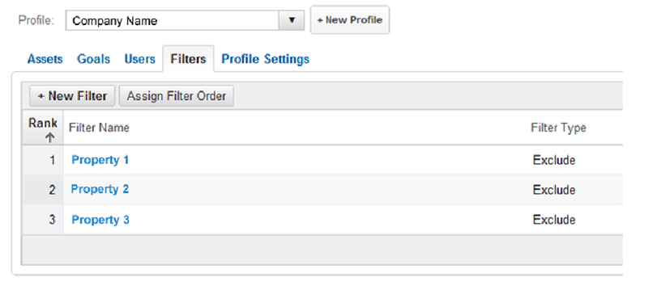
Google Analytics Profiles & Filters
4. Review Account Filters
Setup and maintain multiple Profiles in Google Analytics.
Create and preserve an unfiltered backup profile to make sure that at least one set of retained data will always be complete and accurate.
Other filters may be retired or revised. Worse, exclusions may not be setup correctly, creating a risk of unnoticed data loss. Preserve good data - prepare an unfiltered profile.
Notes:
Account Filters
If there is only one profile setup in Google Analytics, take preventative action.
To make sure that the data will be always accurate, create and keep a backup profile, unfiltered.
Some of these other filters may be retired or re-assigned, as part of a ‘changing of the guard’. Worse, they may not be setup correctly, and there is a risk of losing a month or more of data before it is noticed. Be prepared by maintaining an unfiltered profile to preserve good data in case an issue is created.

Slide 12
Google Analytics Custom URL Tagging
5. Custom URL Tagging
Make inbound traffic attributable at a granular level.
Enable Auto-Tagging for AdWords. For other types of campaigns, use URL Builder.
Google AdWords drives relevant, motivated traffic to websites. Go beyond summary ’organic VS paid’ information to determine the effectiveness of AdWords. Integrate your reporting in a single dashboard. Track AdWords and AdSense Accounts by linking them to your Google Analytics Profile.
Track results with a spreadsheet to make sense of inbound traffic drivers over time.
Assemble Monthly Reports or setup Intelligent Alerts.
www.mysite.com?.utm_source=Google&utm_medium=CPC&utm_campaign=Widgets&utm_content=Comparison
Shorten. Improve reporting insights with parameters for Location, Season, Content, etc.
Add 3 parameters to Tags, at least:
Source (Bing, AdWords, etc)
Medium (CPC, Display, social, etc)
Campaign (#1, summer_contest, etc)
Notes:
Custom URL Tagging
AdWords
Although summary AdWords information is being tracked by Google Analytics, inadequate tracking information is being generated by Google AdWords tracking.
Google AdWords is used by organizations to drive relevant traffic to their sites. Tracking this traffic separately from organic search is critical to determine the effectiveness of AdWords.
To improve accuracy Link your AdWords and/or AdSense with the Analytics account by enabling Auto-Tagging.

Slide 13
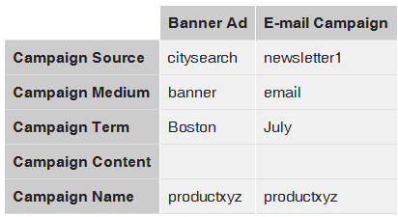
Google Analytics Custom URL Tagging
5. Custom URL Tagging
Know More About the Efficacy of Campaigns Than Simply, Which Channel
Social can generate high referral traffic of quality, with more page views, time-on-site and even larger Average Order Values (AOV). E-mail can produce high conversions.
Optimize efforts: tag each link posted, be it in Social Media, E-mail, Blog, etc. Gain accurate data about which campaigns generate traffic / leads, and which do not.
Benefit: You can track what type of updates engage your followers / fans to generate business – instructional updates VS blog posts VS new products VS special offers…
Over time, figure out which efforts are working best for your business. Adjust time and resources spent, accordingly.
Email Marketing – Newsletter – Banner Ad
Beside is an example of how an Email and Banner Ad campaign should be tagged. Track the resultant data manually to improve efforts.
Notes:
Custom URL Tagging
Social Media
Social should be a primary traffic generator for any kind of business. The quality of that traffic can be very high, with more page views, time-on-site and even larger Average Order Values (AOV). To get out the most of your efforts, tag each link that gets posted on any Social Media Platform. By tagging the links you will have accurate data about your social media campaigns which will give you the best insights of what is working (generates traffic/leads) and what is not.
Benefit: You can track what type of updates engages your SM followers/fans and generates benefits for your business (updates about recipes/blog posts vs. new products vs. special offers)
Over a period of time, you'll be able to figure out which social media sites are working best for your business, and be able to adjust time spent accordingly.
Email Marketing – Newsletters – Banner Ad
Below is an example of how an Email and Banner Ad campaign should be tagged.

Slide 14
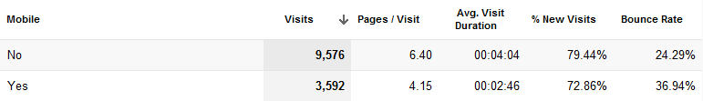
Google Analytics Mobile Traffic & Mobile Conversions
6. Mobile Traffic & Conversions
Detect visits are from users on mobile devices. As below, Mobile may exceed 25% of your traffic so serve them well. Greet cell- and smartphone users with a mobile-friendly version of the website to improve conversion rate to buyers.
Local, retail, restaurant and other consumer businesses enjoy a high proportion of mobile visitor traffic as visitors are out and about. But, larger forces are at work. A majority of adult cell phone owners use the web via mobile. 17% of all adult cell owners are “cell-mostly internet users”*. Ignore at your peril.
* Pew Internet Trust
Does your website at least have a mobile presentation stylesheet? How is that affecting conversion rate compared to the customers who are using non-mobile devices to make purchases?
RECOMMENDED: create a mobile-friendly website presentation with a streamlined flow to conversion. Consider whether to create an entire mobile-only website. Weigh the advantages of developing an App for the most-popular mobile OS’s.
Notes:
Google Analytics Mobile Traffic & Mobile Conversions
From the total of 13,168 visits over a month 3,592 visits are from users using mobile devices. This mobile use is more than 25% of your traffic. Those visitors are far to numerous to ignore. They must be greeted by a mobile-friendly version of the website if you are to have any hope of converting them to buyers.
It is likely that this mobile portion of your visitor traffic is highly seasonal and inspired by summer and potential visitors being out and about. But, larger forces are at work. A majority of adult cell phone use the web via mobile. 17% of all adult cell owners who are “cell-mostly internet users”*. This is too significant a proportion to ignore.
* Pew Internet Trust
Right now the website doesn’t have a mobile stylesheet which resulted in a 2% ($3592) conversion rate compared to 4.3% ($17,725) for the customers who are using non-mobile devices to make purchases.
RECOMMENDED: create a mobile-friendly website presentation with a streamlined flow to conversion.

Slide 15
Google Analytics Micro & Macro Conversions
7. Macro & Micro Conversions
Macro Conversion on this site: add a product to the cart and complete a purchase.
Micro Conversions are other desirable interactions / communications, including:
Download a catalog .pdf
Request a catalog via mail
Get Special Offers & Savings
Review a product
Add to wishlist
Call to order
RECOMMENDED: Setup Conversion Goals for each of the Micro Conversions. Tweak design, content, Calls to Action, then follow with multiple A/B and Multi-Variate (MV) Testing experiments to achieve the best Conversion Rate for each task. This testing process is the key to continuous improvement via Conversion Optimization.
Ultimately, assign revenues to each conversion, as each will provide a measure of value and that will help focus your efforts.
Follow us on Facebook and Twitter
Contact Us
Share this page on Twitter, Facebook, Pinterest, etc.
Subscribe to Newsletter / Email Marketing Campaign
Notes:
Macro vs Micro Conversions
The Macro conversion of the website is adding a product into the cart and completing a purchase.
The Micro conversion of James Candy are the following:
Download a catalog http://www.jamescandy.com/our-catalog
Request a catalog http://www.jamescandy.com/our-catalog
Get Special Offers & Savings
Review a product
Add to wishlist
Call to order
Follow us on Facebook and Twitter
Contact Us
Share this page on Twitter, Facebook, Pinterest etc (not implemented yet)
Sing up for our Newsletter / Email Marketing Campaing (not implemented yet)
RECOMMENDED: In Google Analytics we will have to setup conversion goals for each of the micro conversions listed above. This process will be followed by multiple A/B and Multi-Variate (MV) Testing experiments to achieve the best conversion rate for each task. This testing process is the key to continuous improvement. That is the ‘name of the game’ when it comes to Conversion Optimization.
NOTE: testing will be implemented as part of the Conversion Optimization Design process underway. Thus, we can gauge results and act accordingly.

Slide 16
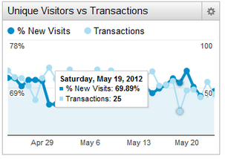
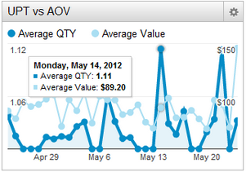
Google Analytics Custom Reports to Maximize Revenue
8. Custom Reporting
% of New Visitors VS Transactions
How are new visitors are influencing the number of transactions? Check this metric when a campaign sends you a lot of traffic to discover if they are converting or not.
Average Quantity VS Average Value
Analyzing any correlation between Average Purchasing Quantity and Average Purchasing Value can be a great way to improve the business logic behind up-selling, bundling, recommended products, etc.
Notes:
Custom Reports to maximize revenue
% of New Visitors VS Transactions
It gives you an idea of how new visitors are influencing the number of transactions. This metric is great when you have a campaign that sends you a lot of traffic, it will tell you right away if they are converting or not
Average Quantity VS Average Value
For E-Commerce websites this report is life-changing. Knowing average purchasing quantity and average purchasing value side by side is great but combining these two and analyzing the correlation between the two metrics can be a great way to improve the up selling recommended products.

Slide 17
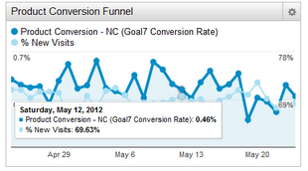
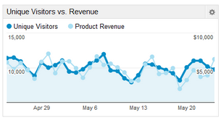
Intro to Google Analytics
8. Custom Reporting
Product Conversion Rate VS %New Visitors
What percentage of New Visitors are purchasing? This metric lags because prospect conversions may require multiple visits. More immediate results may occur if your website sells unique or low-priced products, but even then do not expect a very high conversion rate from first time visitors.
Unique Visitors VS Revenue
A simplistic display of how important it is to increase the number of visitors. Over six months, look for a correlation between more Unique Visitors leading to more sales Revenue.
Notes:
Product Conversion Rate VS %New Visitors
This will tell us how much is the % of new visitors who are purchasing a product. This metric is questionable because most of the new visitors are not buying right away, they like to research many websites before they convert. Exceptions are websites that are selling unique products that cannot be found anywhere else but even then do not expect a very high conversion rate from first time visitors.
Unique Visitors VS Revenue
Having this information will help explaining your client how important is to increase the number of visitors. Usually but this is not a rule! the more unique visitors you have the more you sell. If you take a big picture look (over 6 months) usually you will see a correlation between these two metrics.

Slide 18
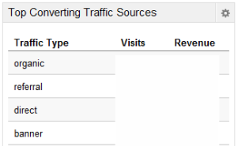
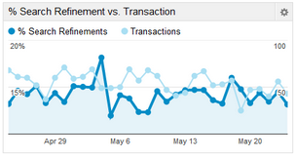
Intro to Google Analytics
8. Custom Reporting
Top Converting Traffic Sources
Knowing which marketing channel brings the most money to the business is always an asset.
% Search Refinement VS Transaction
How the use of Site search correlates to purchases requires a look at this report. Whether using Google Site Search or a custom solution, strive for quality, useful and actionable results for users.
Notes:
Top Converting Traffic Sources
Knowing which marketing channel brings the most money to the business is always an asset.
% Search Refinement VS Transaction
As I said site search metric is very important but having an idea if your site search returns quality result or not will not be possible without a taking a look at this report. There are multiple ways to improve the site search, for example Google site search is an option or another one can be instant suggest with thumbnails similar to apple.com

Slide 19
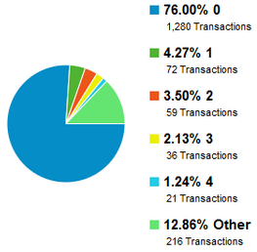
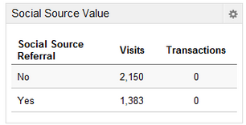
Intro to Google Analytics
8. Custom Reports
Transaction VS Days To Transaction
Similar to Days Since Last Visit but with an E-Commerce focus. Know how many days a buyer needs until conversion. Gather E-mail addresses for lead nurturing, or setup a retargeting campaign, then observe whether it reduces the Days until Transaction and yields a higher number of transactions.
Social Source Value
Social Media can be a very effective traffic source. Here, it generates 40% of the Visitors. How well does that translate to conversions? Enable social media marketing accountability and know how social impacts your business. Go beyond ‘last referring source’ for the real picture.
Notes:
Transaction VS Days To Transaction
This is similar to Days since last visit but it focuses on ecommerce stores. It is very nice to know how many days a buyer needs until he converts. If you have his email address for lead nurturing or you have a retargeting campaign setup, then the days until transaction takes place can be lower and simultaneously, you can have a higher number of transactions.
Social Source Value
Social Media can be a very effective traffic generator, having a traffic source that generates 40% of the visitors is great but by the end of the day we are all looking at conversions. Knowing exactly how much business social media sends us is a must especially when you are investing a decent amount of money into it.

Slide 20
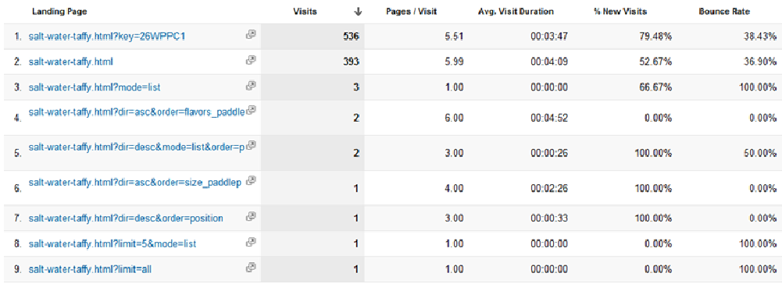
Google Analytics Canonicalization and Rewriting
9. Unify Results for Clarity
salt-water-taffy.html is tracked as 9 different URLs, even though the link shows the exact same product, and the content is exactly the same on each of these URLs. Site Search and dynamic page-creation parameters are causes.
Consolidate results for what is essentially the same page, and avoid confusing reports.
RECOMMENDED: Setup Canonical Tags on the website to focus search crawlers on one instance of the page for better SEO. A Regex Filter in Analytics will rewrite all the URLs and considers all the links as being the same for purposes of reporting here in Analytics.
Notes:
URL Canonicalization and Rewrite
What we can see below is that http://www.jamescandy.com/shop-by-product/salt-water-taffy.html is tracked 9 times, even if the link shows the exact same product, and the content is exactly the same on each of these URLs.
It is advisable to consolidate the results for what is essentially the same page, and avoid these types of reports and the struggle of trying to find the real numbers for a certain landing page.
RECOMMENDED: we will have to setup two the following:
Canonical Tags on the website will focus search crawlers on one instance of the page for better SEO
A Regex Filter that rewrites all the URLs and considers all the query followed links as being the same for purposes of the reporting here in Analytics. (NOTE: this is distinct from URL Re-Writing which should not be necessary in this case).

Slide 21
Google Analytics, ‘Traffic Source (not provided)’
10. Source: ‘(not provided)’
A recent Google Analytics Update introduced “Not Provided” under the keyword section. This conceals the keywords that users queried to click-through to the website. It applies to users who searched while logged into a Google account.
Improve keyword focus with a better understanding of how almost 10% of the traffic arrived on the website, and what type of Keyword influenced a significant number of Transactions.
RECOMMEND: Create a Custom Segmentation Report to calculate the number of visitors (not provided) to each particular page.
An Excel spread sheet will help calculate the percentage of traffic delivered via branded VS non-branded keywords. Then apply this ratio to extrapolate the keyword type used when ‘not provided’. This process helps identify the search terms (keyword queries) your customers are using so we can create content for better keyword focusing. You Project Manager can create this simple spreadsheet each month. It can help inform their SEO efforts, and they can share it with you for a better understanding of your organic search traffic’s keyword use.
Notes:
Traffic Source, Not Provided
A recent Google Analytics Update introduced “Not Provided” under the keyword section. This actually hides all the keywords that were used to get on the James Candy website from the users who are logged into a google account.
To improve keyword focus, we need to have a better understanding of how almost 10% of the traffic arrived on the website.
RECOMMEND: Create a custom segmentation report which will show us the number of visitors (not provided) to a particular page. By creating an additional Excel spread sheet we will determine the percentage of branded vs non-branded keywords and use this data to discover the keyword type they used when they landed on the website as a whole. This process is needed to identify the search terms (keyword queries) your customers are using so we can create content for better keyword focusing. You Project Manager can create this simple spreadsheet each month. It can help inform their SEO efforts, and they can share it with you for a better understanding of your organic search traffic’s keyword use.

Slide 22
Google Analytics Funnels: Added to Cart from…
Tip #1: Funnels: Added to Cart
When a customer can make a purchase multiple ways, it can mix results from the website and obscure the true decision page that led visitors to add an item to the cart.
In some websites, items may be added to the Cart from the homepage. In this case, we want to differentiate Cart additions…
From the Product Page..
From the Category Page
To have a better understanding of how to optimize each page we will have to setup two conversion goals,
category page checkout process and
product page checkout process.
These reports will give as a perspective of how the users are behaving. Then, we may optimize the design, content or Add to Cart Button on each page to generate more conversions.
Notes:
Funnels: Product Page Add to Cart VS Category Page Add to Cart performance
There are two ways a customer can make a purchase. This mixes results from the website and obscures the true decision page that led visitors to add an item to the cart.
From the product page
From the category page
To have a better understanding of how to optimize each page we will have to setup two conversion goals,
category page checkout process and
product page checkout process.
These reports will give as a perspective of how the users are behaving and a great insight of how to optimize the Add to Cart Button on each page to generate more conversions.

Slide 23
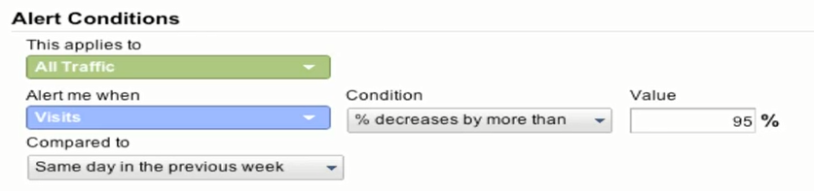
Google Analytics Intelligence – Alerts
Tip #2: Alerts
Google Analytics' Intelligence Reports automatically monitor your website's traffic and highlight any significant changes. Notices can be sent out by E-mail to evoke a rapid response.
Any business-critical website must have custom alerts, so the webmaster can fix / examine causes of any unusual behavior. Agents should get early warning to demonstrate agility.
Traffic decreases by x%
This alert will inform you whenever the website gets less than X% of traffic compared to last week. It is critical to know as soon as possible to fix this issue.
Notes:
Google Inteligence - Alerts
Google Analytics' Intelligence reports automatically monitor your website's traffic and highlight any significant changes. Notices can be sent out by E-mail to evoke a rapid response.
Any business-critical website must have custom alerts, so the webmaster can fix/take a look what caused any unusual behavior.
Traffic decreases by x%
This alert will inform you whenever the website gets less than x% of traffic compared to last week. It is critical to know as soon as possible to fix this issue.

Slide 24
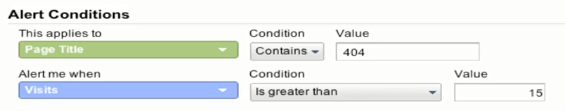
Google Analytics Intelligence – Alerts
Tip #2: Alerts
Press mentions This alert will inform you who linked to you and sent a lot of traffic. This can be very informative from a Reputation Management point of view (good and bad )
404 Page Alert This alert will notify you as soon as people access parts of your website that are broken. Very helpful to detect broken links as quickly as possible.
Notes:
Press mentions
This alert will inform you who linked to you and send a lot of traffic. This comes great for reputation management point of view (good and bad )
404 page alert
This alert will let you know as soon as people are visiting parts of your website that are broken. Comes very helpful to detect broken links as quick as possible.

Slide 25
Google Analytics Intelligence – Alerts
Tips #2: Alerts
Goals Stop Working
This alert is handy to detect whenever the website is not converting or the checkout process (website) is not working properly. (Kind of a Big Deal!)
Thank you for reviewing this model Google Analytics Audit. We think you’ll agree that there are opportunities to better understand how your visitors arrive on the website, and how well they are served once they do arrive. Through ongoing review of the data, your web business can hope to attain its best results in terms of conversions and revenue.
Try some techniques described. Please contact WebiMax should you require assistance.
Notes:
Goals Stop Working
This alert comes handy to detect whenever the website is not converting or the checkout process (website) is not working properly.
Thank you for reviewing this model Google Analytics Audit. We think you’ll agree that there are opportunities to better understand how your visitors arrive on the website, and how well they are served once they do arrive. Through ongoing review of the data, your web business can hope to attain its best results in terms of conversions and revenue.
Try some techniques described. Please contact WebiMax should you require assistance.

Slide 26
Google Analytics Tools and Resources
Tip #3: Tools & Resources
Know the basics & important features? Tools can speed your testing and audits.
WASP - http://webanalyticssolutionprofiler.com/
FireFox Add-On WASP allows you to do fast Quality Assurance testing on your analytics tagging without the drudgery of examining source code.
See and test your tags, save time, see detected values, find missing tags, detect double tagging, capture flash events, export data. Free for 20-page crawls. Paid License for those serious about audits.
Analytics HealthCheck - http://www.analyticspros.com/tools/health-check/
Analytics HealthCheck detects problems with Google Analytics data by scanning your Google Analytics profile, analyzing data points against a statistical model that identifies anomalies in your data caused by problems with your Google Analytics installation. Its use requires one to enable one-time authentication access to Analytics data through your own browser. Checks Google Analytics data for accuracy and reliability. Discovers problems. Pinpoints pages and domains where the problems originate. Identifies changes needed to improve your Google Analytics data reliability and usefulness.
Notes:
Once you know the basics and the reasons why the features are important, tools can speed testing and audits.
WASP - http://webanalyticssolutionprofiler.com/
FireFox Add-On WASP allows you to do fast Quality Assurance testing on your analytics tagging without the drudgery of examining source code.
See and test your tags, save time, see detected values, find missing tags, detect double tagging, capture flash events, export data. Free for 20-page crawls. Paid License for those serious about audits.
Analytics HealthCheck - http://www.analyticspros.com/tools/health-check/
Analytics HealthCheck detects problems with Google Analytics data by scanning your Google Analytics profile, analyzing data points against a statistical model that identifies anomalies in your data caused by problems with your Google Analytics installation. Its use requires one to enable one-time authentication access to Analytics data through your own browser. Checks Google Analytics data for accuracy and reliability. Discovers problems. Pinpoints pages and domains where the problems originate. Identifies changes needed to improve your Google Analytics data reliability and usefulness.

Slide 27
Google Analytics Tools and Resources
Tip #3: Tools & Resources
Know the basics & important features? Tools can speed up testing and audits.
ScreamingFrog - http://www.screamingfrog.co.uk/seo-spider/
This crawler has broadly-applicable features that can be customized by using custom filters. Results for licensed users can be obtained in .CSV format and then sorted variously to detect: script on each page, duplicates, multiple Account codes, etc.
Google Analytics Application Gallery - http://www.google.com/analytics/apps/
This gallery contains applications that extend Google Analytics in new and exciting ways. They are solutions that help analysts, marketers, IT teams, and executives get more out of Google Analytics.
Google Analytics Applications for Site Audit - http://www.google.com/analytics/apps/results?category=Site%20Audit
WebiMax was rated #37 among the Inc. 500 ‘fastest growing U.S. companies’ for 2012. We would be delighted to be of assistance. Please consider us a resource.
Notes:
ScreamingFrog - http://www.screamingfrog.co.uk/seo-spider/
This crawler has broadly-applicable features that can be customized by using custom filters. Results for licensed users can be obtained in .CSV format and then sorted variously to detect script on each page, duplicates, multiple Account codes, etc.
Google Analytics Application Gallery - http://www.google.com/analytics/apps/
This gallery contains applications that extend Google Analytics in new and exciting ways. They are solutions that help analysts, marketers, IT teams, and executives get more out of Google Analytics.
Google Analytics Applications for Site Audit - http://www.google.com/analytics/apps/results?category=Site%20Audit
WebiMax has been rated #37 among the Inc. 500 ‘2012 fastest growing companies’. We would be delighted to be of assistance. Please consider us a resource.
QUESTIONS?
PLEASE SEE THE CONTACTS ON THE FINAL SLIDE… THANK YOU!

Slide 28


Questions?
Michael Stricker, SEO & Social Media Strategist

